Slide 1


E-Commerce Analysis Report
By Rahma Muhamed under Supervision of Eng. Essam

Slide 2
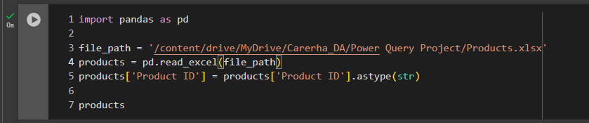
Data Processing & Analysis Steps Summary
1. Data Importing
Imported Excel files:
Products.xlsx (Product data)
Customer Data.xlsx (Customer data)
Imported multiple CSV sales files from the "Sales" folder using os.listdir() and merged them into a single DataFrame.

Slide 3
2. Data Cleaning
.1Products Data:
Converted Product ID to string format.
.2Customers Data:
Read with specific dtypes for Customer ID and Postal Code as string.
Removed fully empty rows.
Extracted only Country and State columns to clean and deduplicate state-level data.
Replaced 'United States' with 'USA'.
Merged cleaned state data back into the original customer DataFrame.
Dropped the redundant column Country_x and renamed Country_y to Country.
.3Sales Data:
Split CSV content separated by ; and set correct column headers.
Dropped the first row (original headers).
Converted the following fields:
Quantity → int
Purchasing Price, Planned Sales Price, Discount → float
Order Date, Shipping Date → datetime (format: %d/%m/%Y)

Slide 4
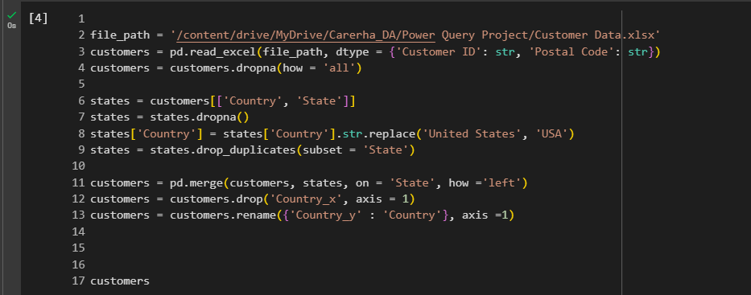
Applied a custom split_col() function to:
Extract the actual Product ID and Customer ID from complex string formats.

Slide 5
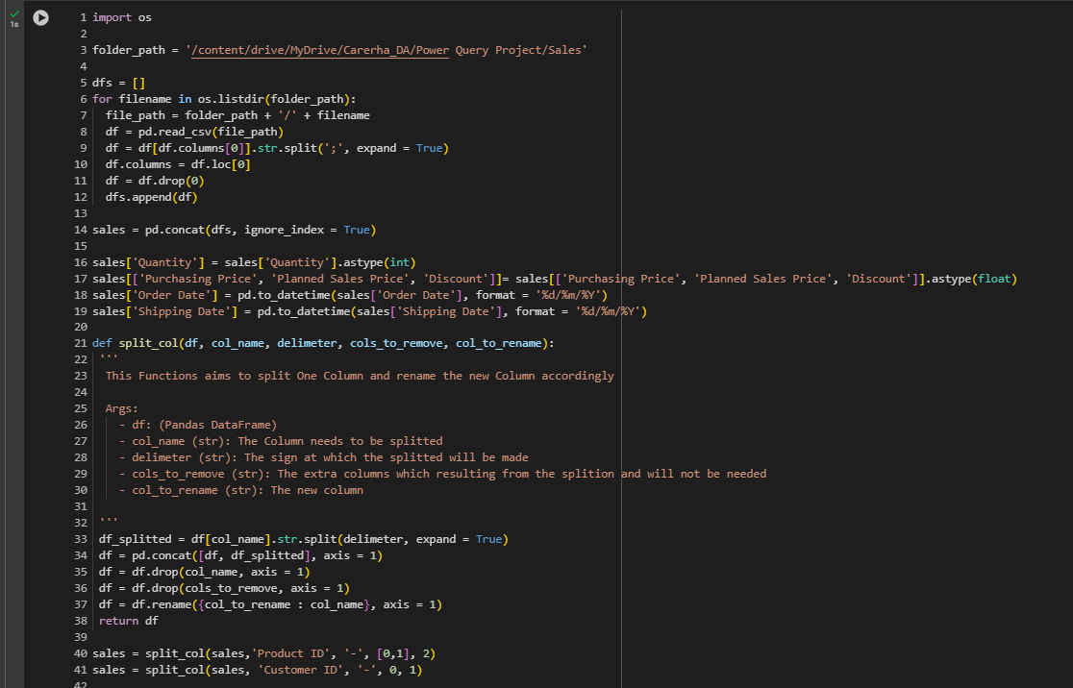

Slide 6
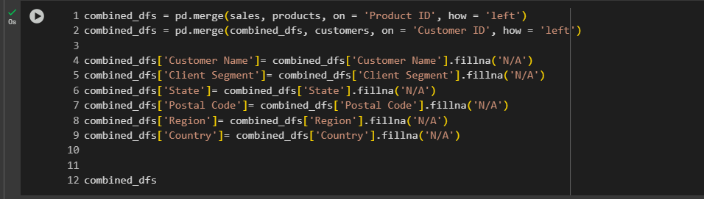
3. Data Merging
Merged sales, products, and customers DataFrames using Product ID and Customer ID.
Filled missing values (NaN) in key fields with 'N/A':
Customer Name, Client Segment, State, Postal Code, Region, Country

Slide 7
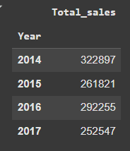
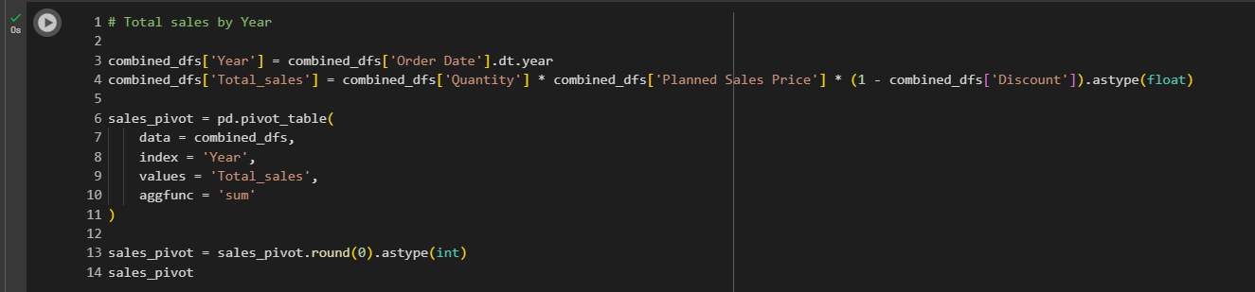
.4Insights & Analysis
-Total Sales Calculations:
Created a new field Total_sales:
ini
Total_sales = Quantity * Planned Sales Price * (1 - Discount)
Extracted Year and Month from Order Date for time-based aggregations.
.1Sales by Year:
Created a pivot table to show Total_sales per year.
Visualized with a line plot.

Slide 8
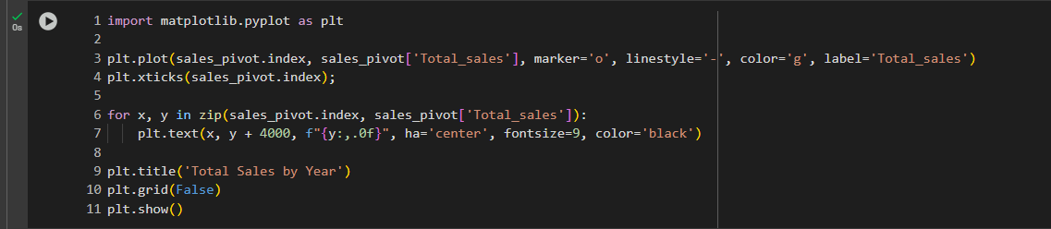
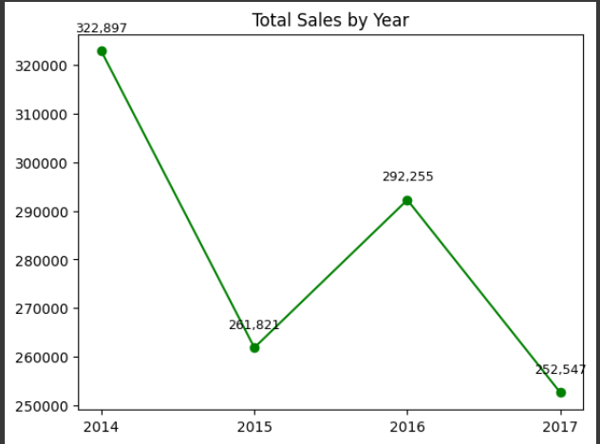
-The chart clearly shows that the year 2014 recorded the highest sales value, while the lowest sales were observed in 2017. -It is recommended to conduct a study to understand the reasons behind the sales peak in 2014, and to apply the relevant successful strategies to help boost future sales.

Slide 9
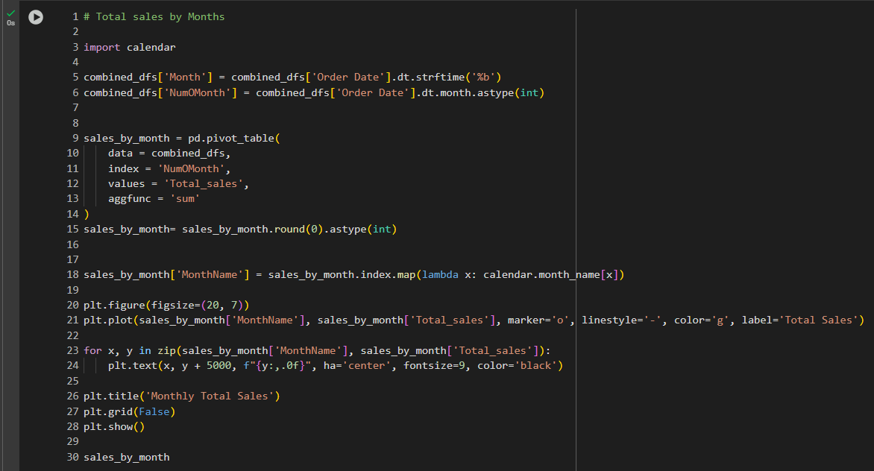
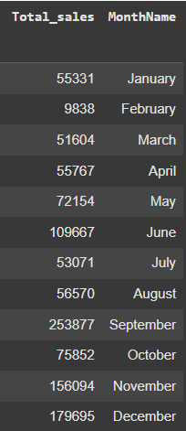
.2Sales by Month:
Extracted both month names and month numbers.
Created a pivot table by month.
Visualized using a line plot.

Slide 10
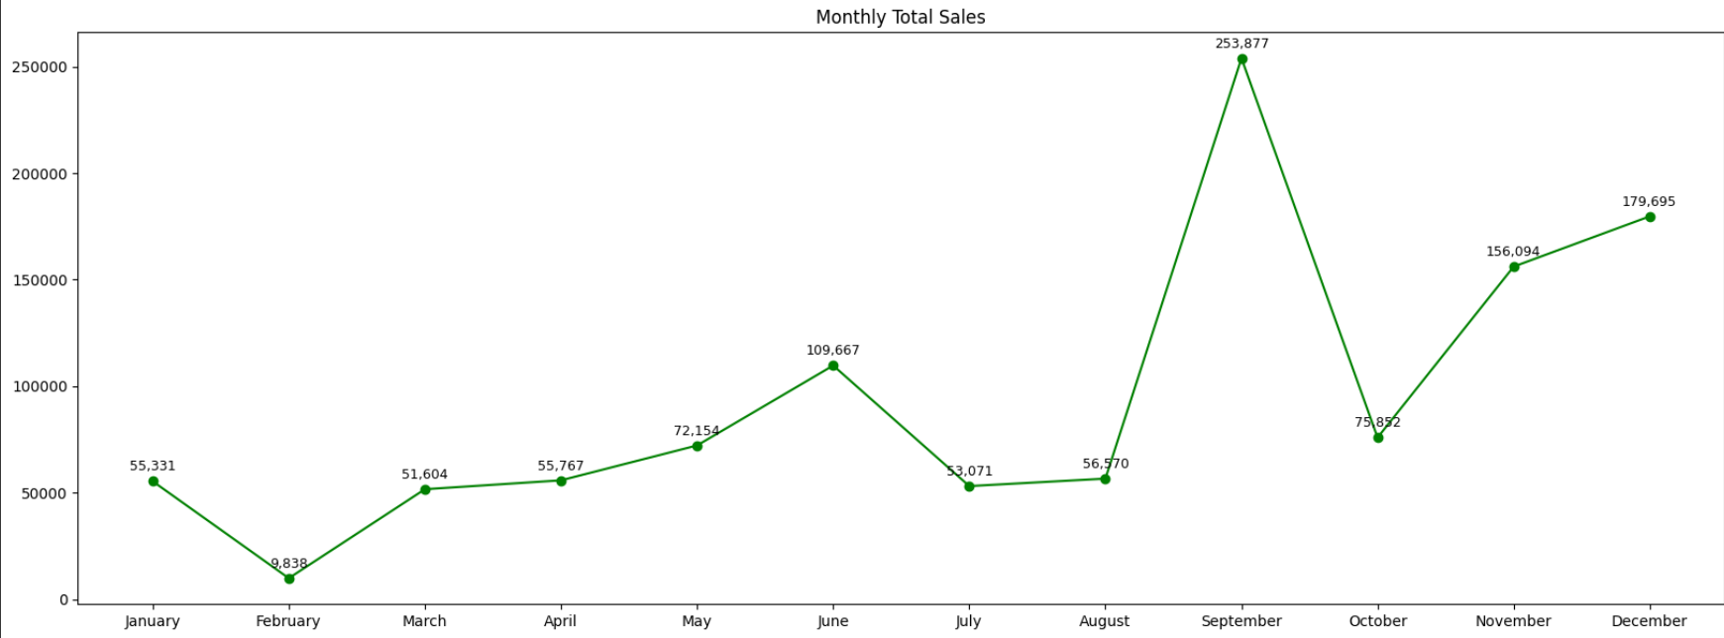
-The chart indicates that September recorded the highest sales value, while February had the lowest sales value among all months.

Slide 11
Recommendations Based on Monthly Sales Performance
Capitalize on Peak Sales Month (September): September recorded the highest sales figures. The company should consider increasing marketing activities and promotional campaigns during this month. Reviewing successful strategies previously applied in September can help replicate the sales boost.
Boost Low-Performance Month (February): February showed the lowest sales. To address this, the company should implement incentive-based offers such as discounts, loyalty rewards, or free shipping. Special campaigns can be launched to drive demand during this low season.
Seasonality Analysis: It is recommended to analyze any external factors (e.g. school season, public holidays, or seasonal demand) that may have contributed to the peak in September. This understanding will help in planning future campaigns accordingly.
Inventory and Supply Chain Planning: Ensure product availability and increase inventory levels before September to meet high demand. In contrast, optimize inventory and reduce excess stock during February to minimize holding costs.
Data-Driven Marketing Campaigns: Leverage data insights to target customer segments that were most active in September. Test new marketing approaches in February (A/B testing) to identify the most effective strategies for improving performance.

Slide 12
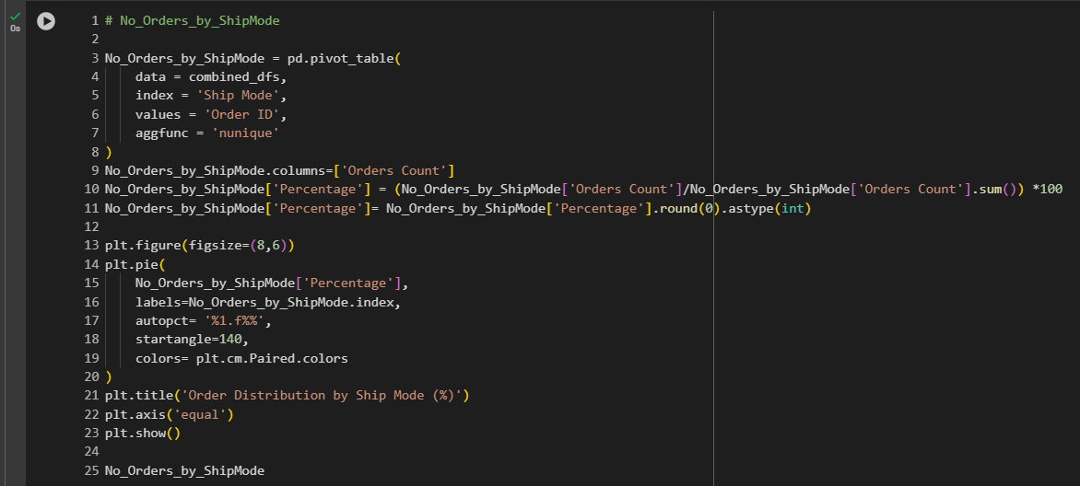
.3Orders by Ship Mode:
Counted unique Order IDs per Ship Mode.
Calculated percentage share.
Displayed using a pie chart.

Slide 13
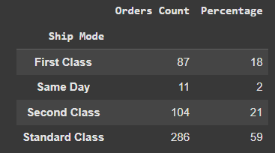
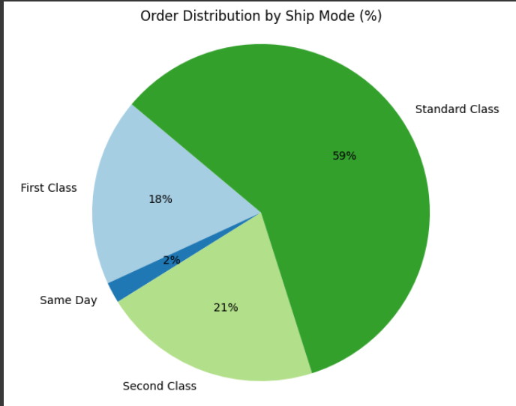
Insights:
Standard Class dominates shipping with 59% of all orders, indicating it is the most commonly used option—likely due to a balance of cost and delivery time.
Same Day shipping is rarely used (only 2%), which may be due to:
Limited availability
Higher costs
Lack of promotion
Second Class and First Class shipping modes are used moderately (21% and 18%, respectively), showing there’s a customer segment that values faster delivery but may be sensitive to cost.

Slide 14
Recommendations:
Evaluate Customer Satisfaction for Standard Class:
Since it handles the majority of orders, ensure that delivery times, condition of goods, and communication are consistently high-quality.
Consider offering loyalty perks for repeat users of this option.
Promote Same Day Delivery More Effectively:
Explore why this mode is underutilized. If it's due to cost, consider promotional discounts or bundling offers.
Highlight this option in checkout or in targeted marketing for urgent-use products.
Segment Customers by Shipping Preference:
Use this data to tailor campaigns—e.g., target premium clients with First Class perks or upsell fast shipping to high-value customers.
Optimize Operations:
If logistics capacity allows, experiment with reducing delivery times for Standard Class to compete with faster methods while maintaining lower costs.
A/B Test Shipping Options in Checkout:
Test different default shipping settings to see how it affects customer choice and overall satisfaction.

Slide 15
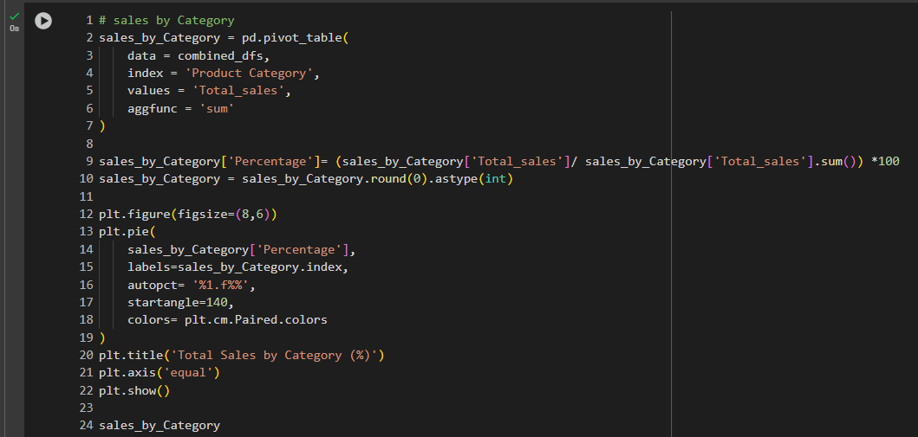
.4Sales by Product Category:
Summed total sales by Product Category.
Calculated percentage share.
Visualized with a pie chart.

Slide 16
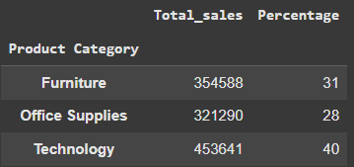
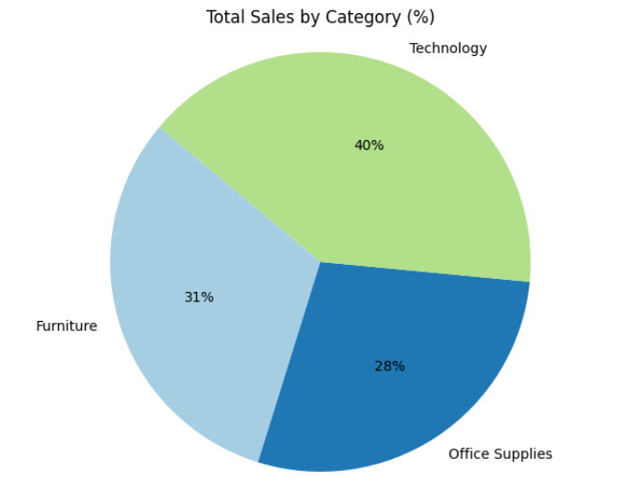
Insights:
Technology is the top-performing category, generating 40% of total sales, making it the strongest revenue driver.
Furniture and Office Supplies are relatively close in performance, contributing 31% and 28% respectively.
While the three categories are fairly balanced, Technology clearly leads, possibly due to higher unit prices or stronger customer demand.
Recommendations:
Double Down on Technology:
Expand the range of tech products and consider bundling offers (e.g. printer + accessories).
Invest more in digital marketing and retargeting campaigns focused on tech buyers.
Cross-Sell Between Categories:
Bundle Office Supplies with Furniture (e.g. desks with filing systems).
Suggest complementary tech products when selling office furniture (e.g. ergonomic desks with monitor arms).

Slide 17
Analyze Furniture Performance:
Although it contributes 31% of sales, check if margins are healthy.
Explore new styles, space-saving designs, or promotions targeting SMEs and startups.
Boost Office Supplies Through Volume Deals:
Run B2B campaigns with bulk order discounts.
Consider subscription models for recurring items (e.g. paper, pens).
Segment Campaigns by Category Behavior:
Use category performance to guide your audience segmentation in ads—tech-focused vs. workspace-focused customers.

Slide 18
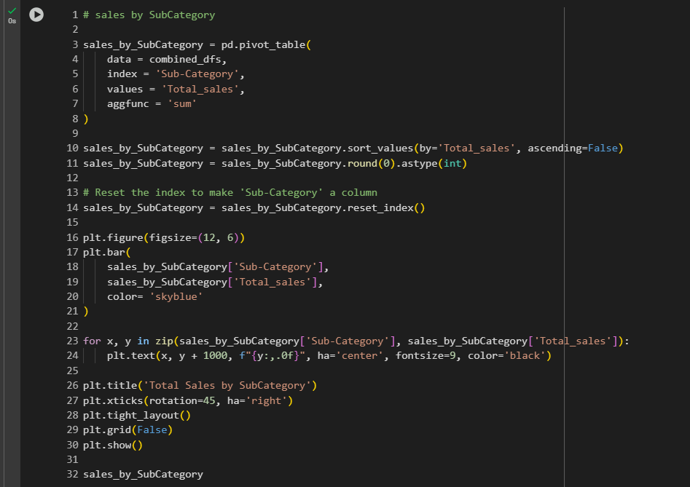
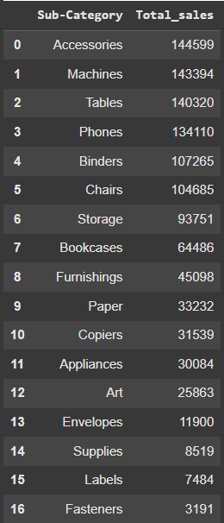
.5Sales by Sub-Category:
Ranked sub-categories by total sales.
Displayed using a bar chart.

Slide 19
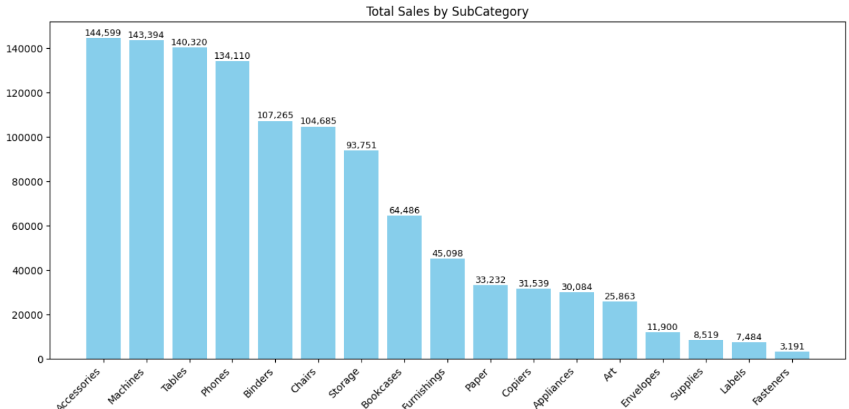

Slide 20
Insights:
Top performers include:
Accessories, Machines, Tables, and Phones — each generating above 130,000 in sales, indicating high demand or high unit value.
Underperforming sub-categories include:
Fasteners, Labels, Supplies, and Envelopes — all below 12,000 in total sales, indicating limited customer interest or possible under-marketing.
There is a clear long-tail distribution, where a few sub-categories contribute a large portion of revenue, while many others contribute marginally.
Recommendations:
For High-Performing Sub-Categories:
Maintain Inventory & Visibility:
Ensure continuous stock availability for Accessories, Machines, Phones, and Tables.
Feature them prominently on the website and in promotional banners.
Leverage Best-Sellers in Campaigns:
Use top items in marketing creatives to attract clicks and conversions.
Cross-sell and upsell from these products to lower-performing items.

Slide 21
For Low-Performing Sub-Categories:
Reevaluate Product Strategy:
Analyze whether Fasteners, Labels, Supplies etc. are essential to keep, or if they consume resources without ROI.
Consider phasing out or minimizing SKUs in these categories.
Revive Through Promotions or Bundling:
Bundle small-ticket items like Envelopes or Labels with more popular products.
Run clearance deals or include them as free gifts in large orders.
General Strategic Advice:
Customer Behavior Segmentation:
Segment customers based on sub-category preferences (e.g., tech-focused vs. office furniture buyers).
Use email campaigns or dynamic content to recommend matching sub-categories.
Expand Variants in Strong Categories:
Add more variety (colors, styles, use cases) in high-selling categories like Accessories and Machines.

Slide 22
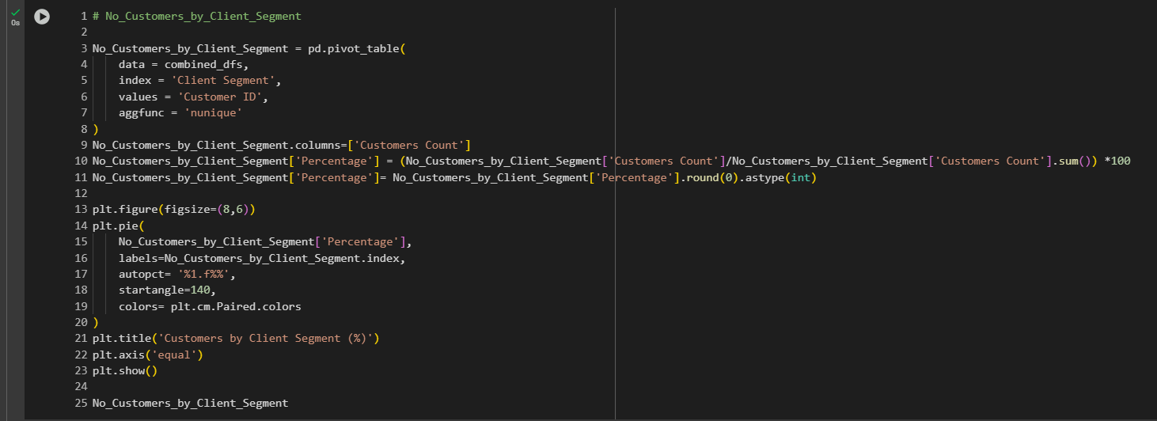
.6Customers by Client Segment:
Counted unique Customer IDs per Client Segment.
Calculated percentage share.
Visualized using a pie chart.

Slide 23
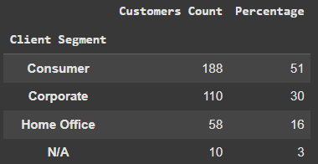
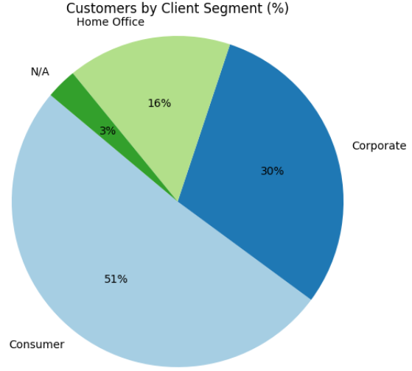
Insights:
Consumer segment represents the majority of the customer base (51%), indicating strong appeal to individual buyers or B2C markets.
Corporate clients make up 30%, which is significant and likely represents high-value orders.
Home Office is a smaller segment (16%) but may have untapped potential, especially post-COVID as remote work trends continue.
N/A (3%) likely indicates missing or unclassified data — which could affect accuracy of targeting.
Recommendations:
1. Focus on the Consumer Segment:
Keep strengthening your B2C strategies through targeted campaigns, product personalization, and loyalty programs.
Highlight ease of use, affordability, and convenience in product messaging.

Slide 24
2. Expand Corporate Relationships:
The Corporate segment (30%) is promising — develop tailored B2B packages, volume discounts, and account management services.
Consider offering longer-term contracts or subscription models for corporate clients.
3. Grow the Home Office Market:
Run dedicated campaigns targeting freelancers, consultants, and remote workers.
Offer compact office furniture, productivity tools, and bundles optimized for home use.
4. Address Missing Segment Data:
Investigate the 3% labeled as "N/A" — add mandatory fields in customer onboarding forms to capture accurate segmentation.
Clean and enrich customer profiles to enable better targeting in the future.

Slide 25
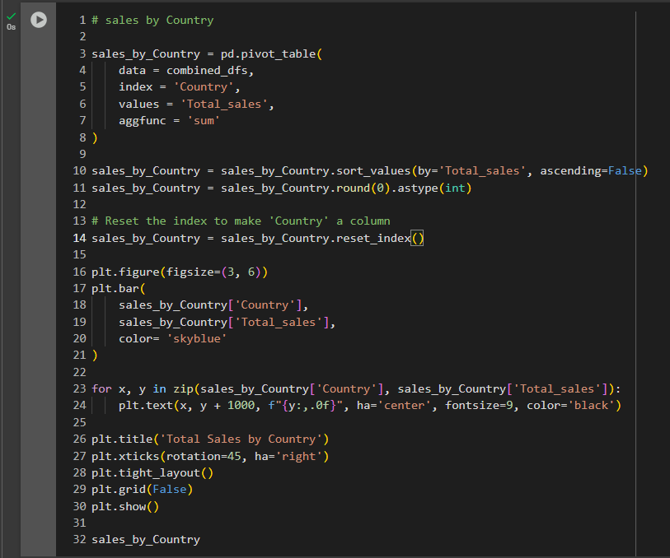
.7Sales by Country:
Summed total sales by Country.
Visualized using a bar chart.

Slide 26
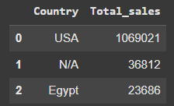
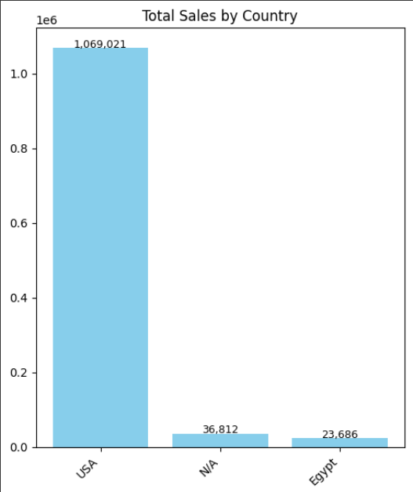
Insights:
The USA is the leading market, generating the highest total sales of $1,069,021. This highlights a strong market presence and customer base in the U.S.
Egypt appears to be an emerging market, with total sales of $23,686. Although relatively low, it indicates potential for regional growth if supported by localized strategies.
“N/A” accounts for $36,812 in sales, suggesting missing or incomplete country data. This could impact the accuracy of geographical performance analysis and decision-making.
Recommendations:
Continue investing in the U.S. market through retention strategies, personalized campaigns, and operational improvements, as it’s clearly the business’s core revenue driver.
Explore opportunities to grow the Egyptian market by:
Launching localized marketing campaigns
Offering Arabic-language support
Partnering with regional logistics or retail platforms

Slide 27
Address missing country data (N/A):
Ensure that the “Country” field is mandatory in all order and customer data systems
Audit and clean past records to improve reporting accuracy and insights
Consider regional expansion in similar markets across the Middle East and North Africa (e.g. UAE, KSA), especially if Egypt shows positive traction.

Slide 28
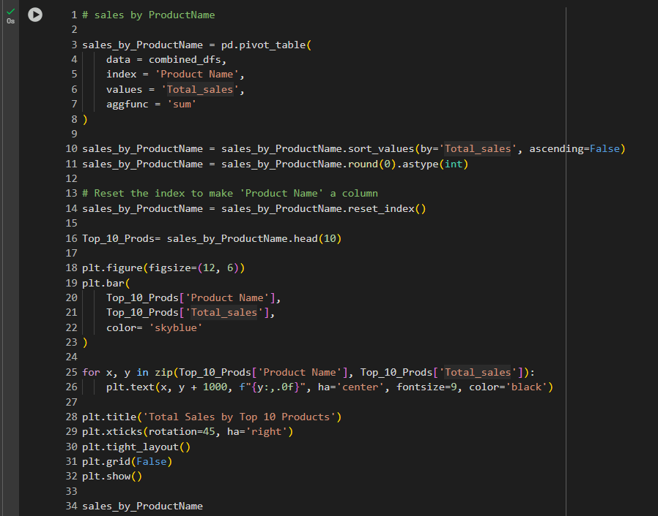
.8Top 10 Products by Sales:
Ranked products by total sales.
Displayed the top 10 using a bar chart.

Slide 29
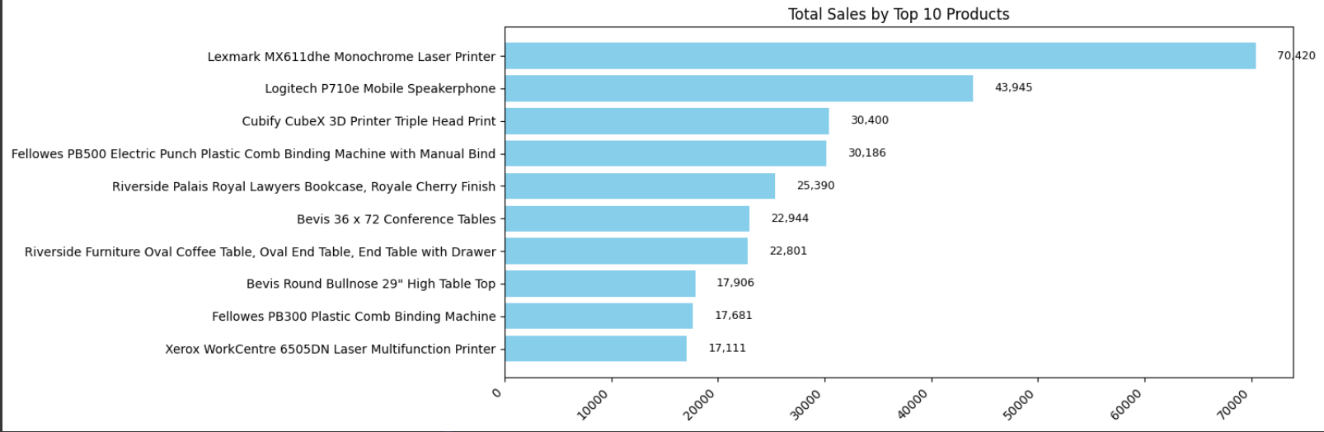

Slide 30
Insights:
"Lexmark MX611dhe Monochrome Laser Printer" is by far the best-selling product, with over 70,000 in sales — a clear leader in the portfolio.
The second product, "Logitech P710e Mobile Speakerphone", has strong performance too (approx. 44,000), but there's a clear gap between it and the top product.
Most of the remaining top products generate between 17,000 and 30,000 in sales — showing a relatively balanced mid-tier performance.
The mix includes technology products (printers, speakerphones), furniture (tables), and binding machines — indicating a diverse customer demand.
Recommendations:
Focus on the top-selling printer with dedicated marketing and featured placements.
Bundle top products (printers, speakerphones, binding machines) to boost sales and average order value.
Upsell from mid-tier to top-tier products through targeted offers and remarketing.
Maintain category diversity as both tech and furniture are contributing well.
Prioritize high-margin products when planning promotions and inventory.

